Slide 1
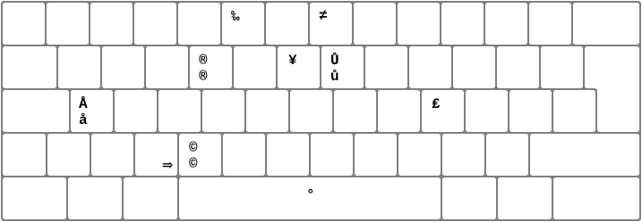
Esc. : Close Video / PDF / Iframe
(beta functionnality)
1~6 : Move to Panel #
[ : Next Slide (1)
] : Previous Slide (1)
Q : Rotate View Left (1)
E : Rotate view Right
W~S : Move forward / backward (1)
A~D : Strafe left /right (1)
Space : Move to center
of the room
(1) : The key are for a QWERTY keyboard and are matched with to keys in the same position for other keyboards, ie in AZERTY, A will rotate to Left

